Slide 1
Supracondylar fracture of the humerus
P. J. Okoth

Slide 2
Learning objectives
Classify supracondylar fractures of the humerus
State the mechanism of injury of supracondylar fracture
State the clinical features of supracondylar fracture of humerus
Describe the X-ray findings in supracondylar fractures
Describe the treatment modalities for supracondylar fractures
State the complications of supracondylar fracture of humerus

Slide 3
Classification
Supracondylar fractures in children can be classified as follows:
Gartland’s classification
Type I: an undisplaced fracture
Type II: an angulated fracture with the posterior cortex still in continuity
Type IIA: a less severe injury with distal fragment merely angulated
Type II B: a severe injury; the fragment is both angulated and malrotated
Type III: a completely displaced fracture

Slide 4
Classification …
Classification
Type | Description
I | Non-displaced
II | Angulated with intact posterior cortex
III | Complete displacement

Slide 5
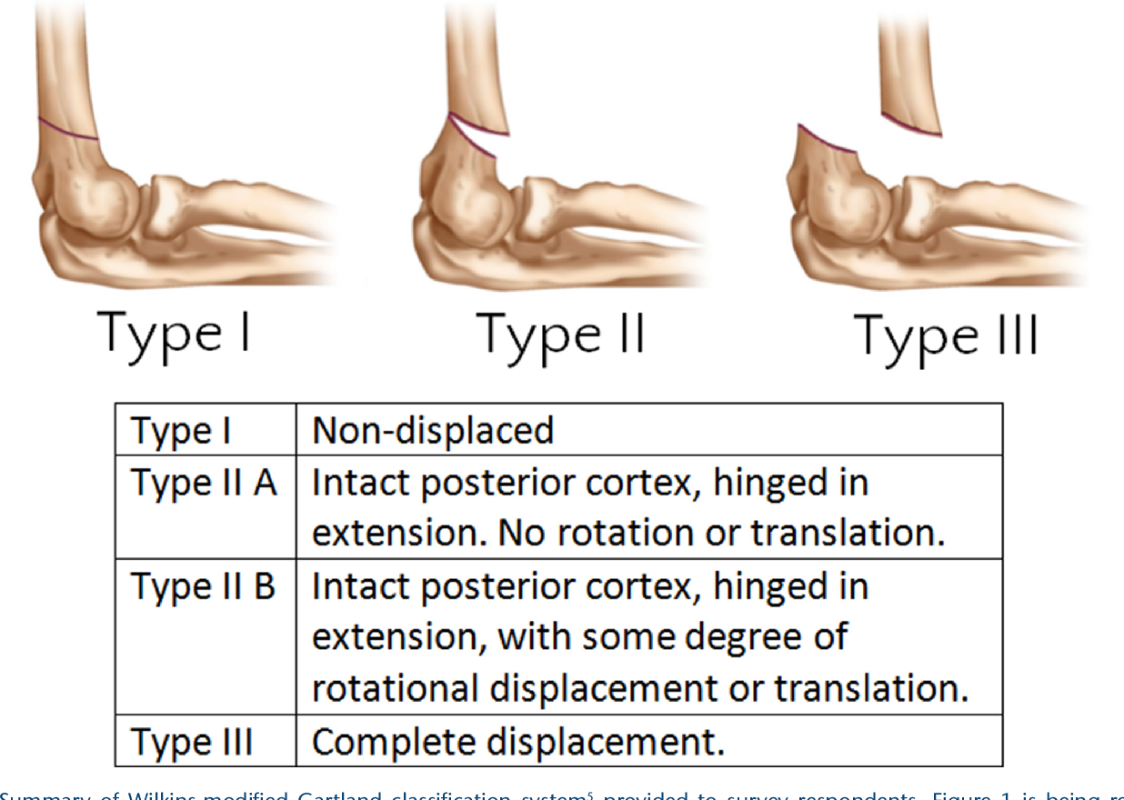

Slide 6
Mechanism of injury
Posterior angulation or displacement suggests a hyperextension injury, usually due to a fall on the outstretched hand.
The humerus breaks just above the condyles
The distal fragment is pushed backwards and twisted inwards
The jugged end of the proximal fragment pokes into the soft tissues anteriorly, sometimes injuring the brachial artery or median nerve.
Anterior displacement is rare. Due to direct violence e.g. a fall on the point of the elbow with the joint in flexion.

Slide 7
Clinical features
Pain
Elbow is swollen
S-deformity in a posteriorly displaced fracture
Abnormal bony landmarks at elbow
Feel the pulse / check capillary return to rule out vascular injury
Rule out nerve injury by examining wrist and hand
95% of all cases are posteriorly angulated

Slide 8
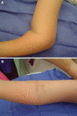
Clinical appearance of a Type III supracondylar fracture.
(a) The lateral view of the elbow demonstrates an S-shaped deformity.
(b) The anterior view of the antecubital fossa demonstrates anterior ecchymosis from the anterior spike of the fracture piercing ...

Slide 9
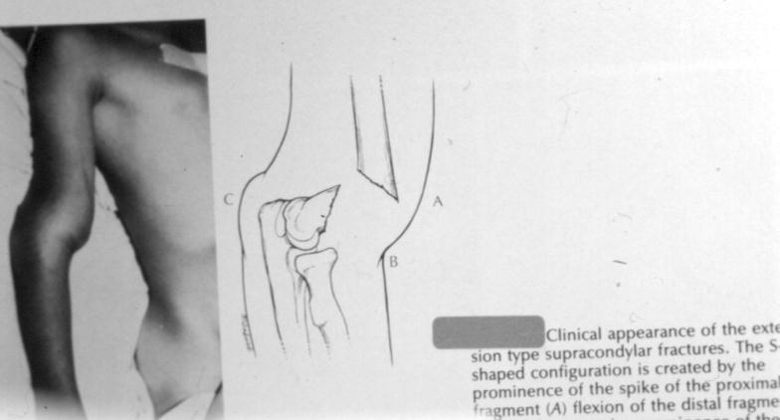
Clinical appearance – type III

Slide 10
X-ray findings
Fracture is seen most clearly in the lateral view.
Posteriorly displaced fracture:
Fracture line runs obliquely downwards and forwards
Distal fragment is tilted backwards and /or shifted [displaced] backwards
Anterior displacement:
Fracture line runs downwards and backwards and the distal fragment is tilted forwards

Slide 11
X-ray findings…
On a normal lateral x-ray a line drawn along the anterior cortex of the humerus should cross the middle of the capitulum.
If the line is anterior to the capitulum then a type II fracture is suspected.

Slide 12
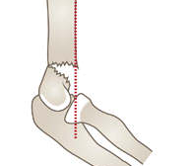
Type II fracture
Angulated with intact posterior cortex

Slide 13
X-ray findings…
Baumann’s angle in AP view X-ray:
This is the angle subtended by the longitudinal axis of the humeral shaft and a line through the coronal axis of the capitellar physis.
Normally, this angle is less than 80 degrees.
If the distal fragment is tilted in varus, the increased angle is readily detected.

Slide 14
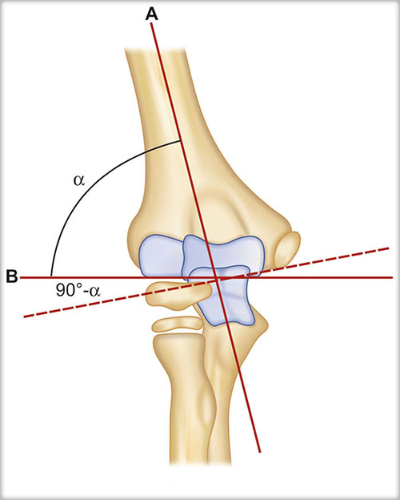
Baumann’s angle

Slide 15
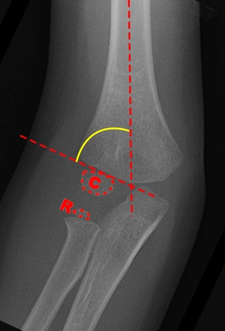
Baumann’s Angle

Slide 16
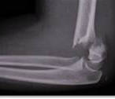
Supracondylar #

Slide 17
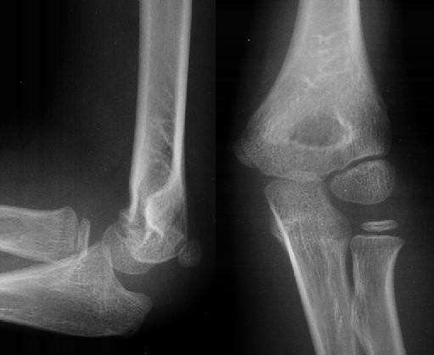
Normal alignment
See relationship between anterior cortex of humerus and capitulum

Slide 18
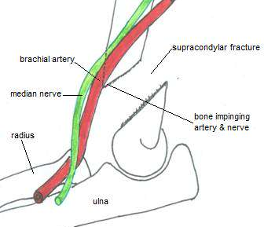
Structures at risk
Brachial artery and median nerve are especially at risk of injury by the sharp edge of the anteriorly pointing proximal fragment.

Slide 19
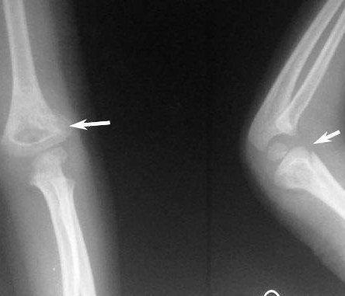
Supracondylar fracture of humerus

Slide 20
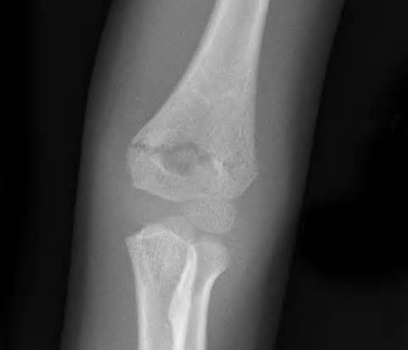
AP view

Slide 21
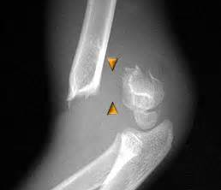
TYPE III Supracondylar # of humerus
Completely displaced

Slide 22
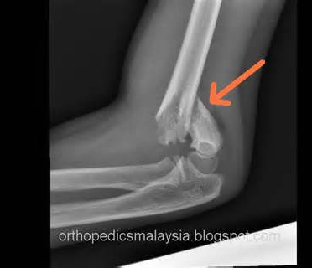
Type III Fracture

Slide 23
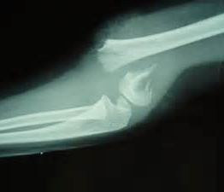
Type III fracture
See the S-shape deformity

Slide 24
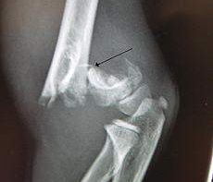
Type III fracture

Slide 25
Treatment
Type I: undisplaced fracture
Elbow is immobilized at 90 degrees and neutral position
Use a light-weight splint or cast.
Support arms in a sling
Do check x-ray 5-7 days later to check for any displacement
Retain plaster for 3 weeks

Slide 26
Treatment …
Type IIA: posteriorly angulated fracture – mild
Swelling is usually not severe and risk of vascular injury is low.
Reduction is done under G/A in steps:
Traction for 2-3 minutes in the length of the arm with counter-traction above the elbow
Correction of any sideways tilt or shift and rotation
Gradual flexion of the elbow to 120 degrees, and pronation of the forearm, while maintaining traction and exerting finger pressure behind the distal fragment to correct posterior tilt.

Slide 27
Treatment…
Type IIA continued…
Feel the pulse and check capillary return.
If distal circulation is suspect, immediately relax the amount of elbow flexion until it improves.
X-rays are taken to confirm reduction
Following reduction the arm is held in a plaster back-slab and the arm supported in a collar and cuff; the circulation is checked repeatedly during the first 24 hours.
X-ray is done after 3-5 days to confirm that the fracture has not shifted.
The splint is retained for 3 weeks after which movements are began.

Slide 28
Treatment…
Type II B and III: angulated and malrotated or posteriorly displaced.
Usually associated with severe swelling
Are difficult to reduce
Often unstable
There is considerable risk of neurovascular injury or circulatory compromise due to swelling.
Reduced under G/A as in type IIA, then held by percutaneous crossed K-wires with elbow acutely flexed, care being taken not to injure the ulnar, radial and median nerves.

Slide 29
Treatment…
Type IIB and III continued…
Open reduction:
Necessary for:
Fracture that cannot be reduced by closed manipulation
An open fracture
A fracture associated with vascular damage
The fracture is exposed, preferably through 2 incisions, one on each side of the elbow, the haematoma is evacuated and the fracture is reduced and held by two crossed K-wires.

Slide 30
Treatment…
Type IIB and III continued…
Continuous traction [Dunlop traction]
Traction through a screw in the olecranon, with the arm held overhead can be used:
If the fracture is severely displaced and cannot be reduced by manipulation
If with the elbow flexed 100 degrees, the pulse is obliterated
For severe open injuries or multiple injuries of the limb
Once the swelling subsides, a further attempt can be made at closed reduction.

Slide 31
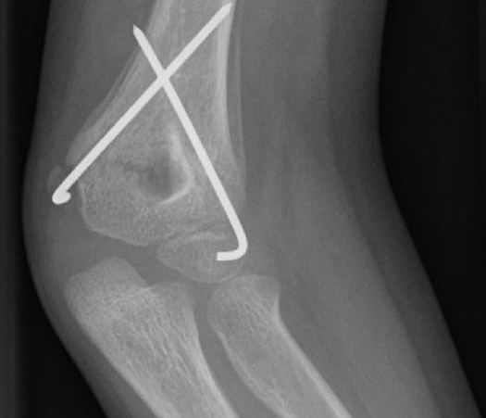
Fixed with K-wires
Closed reduction and percutaneous pinning is the preferred treatment for displaced or unstable fractures.

Slide 32
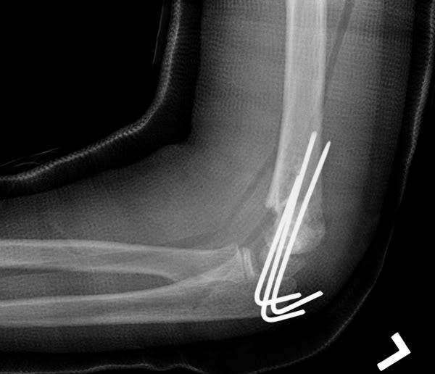
Management
Fracture fixed with K-wires and held in cast

Slide 33
Complications of supracondylar fracture of the humerus
Early complications
Vascular injury – injury to the brachial artery
Forearm oedema and a mounting compartment syndrome leads to necrosis of the muscles and nerves without causing peripheral gangrene.
Signs and symptoms
Undue pain plus pain on passive extension of the fingers
Tense and tender forearm
Absent pulse
Blunted sensation
Reduced capillary return

Slide 34
Complications…
Early complications
Nerve injury
Median – most commonly injured
Radial
Ulnar
Loss of function is usually temporary.
Recovery can be expected in 3-4 months.

Slide 35
Complications…
Late complications
Malunion is common
Varus defromity of the elbow
Valgus deformity of elbow
Cubitus varus produces the ‘gun-stock deformity’
Elbow stiffness
Myositis ossificans
Volkmann’s ischaemic contracture

Slide 36
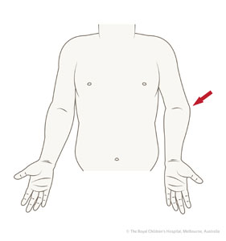
Cubitus varus

Slide 37

Volkmann’s ischaemic contracture

Slide 38
The end
Thanks

